Slide 1
Bluetooth Protocol Stack
~ Neel Doshi - 23

Slide 2
What is Bluetooth
Bluetooth network technology connects mobile devices wirelessly over a short-range to form a personal area network (PAN)
Key Features of Bluetooth
The transmission capacity of Bluetooth is 720 kbps.
Bluetooth is a wireless device.
Bluetooth is a Low-cost and short-distance radio communications standard.
Bluetooth is robust and flexible.
The basic architecture unit of Bluetooth is a piconet.
Used In :

Slide 3
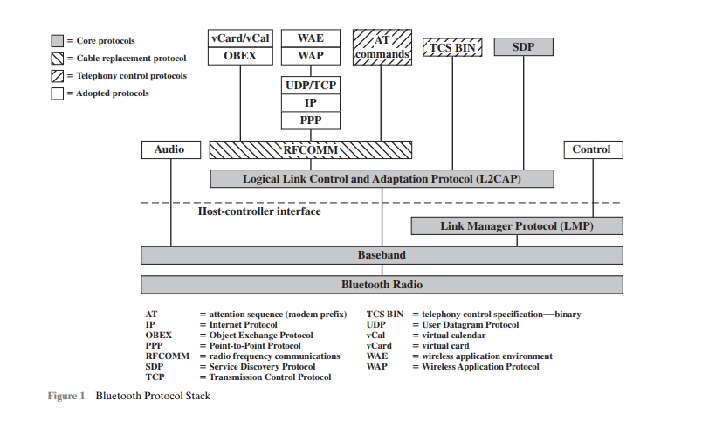
1. Bluetooth Protocol Stack

Slide 4
Thank You

